Slide 1
Init, initial commit
Alle stappen om een project met master-branch aan te maken.
$ git init
Initialized empty Git repository in ...
$ git config user.name "tim"
$ git config user.email "tim@email.com"
$ touch README.md
$ git add README.md
$ git commit -m "Add README.md"
[master (root-commit) e23e4e0] Add README.md
1 file changed, 0 insertions(+), 0 deletions(-)
create mode 100644 README.md

Slide 2
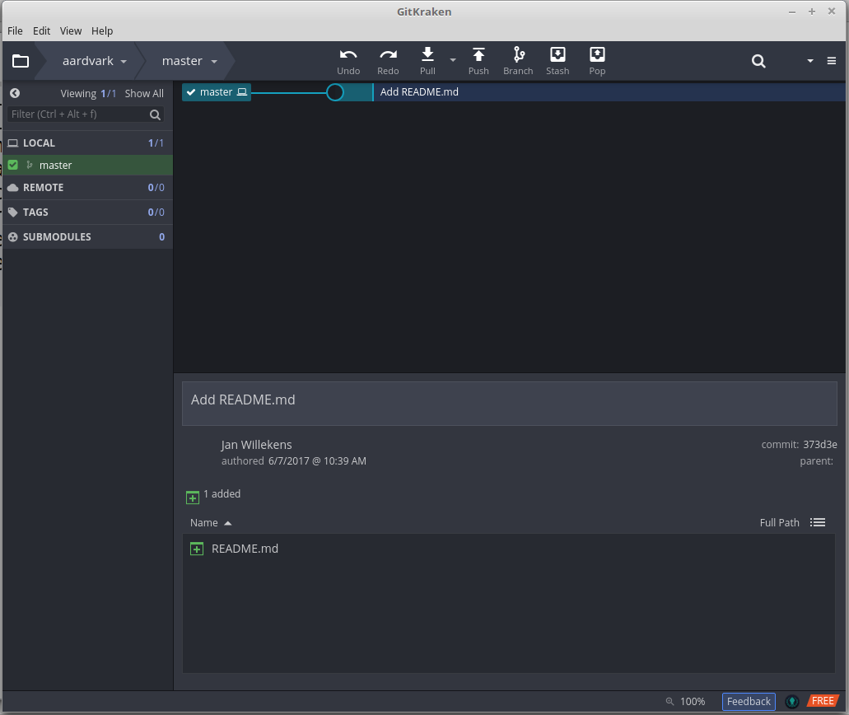

Slide 3
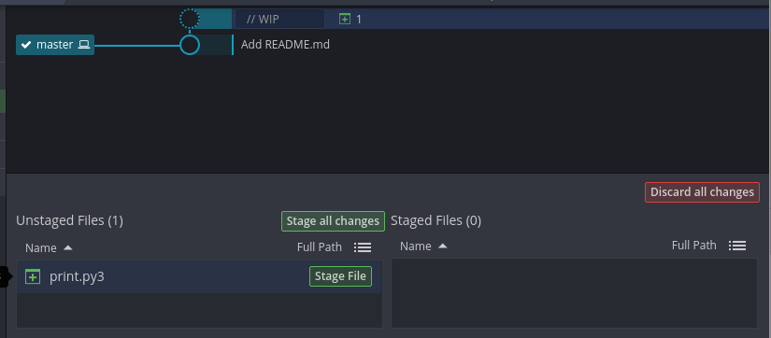
Unstaged (WIP Work in progress)
# maak print.py3 aan
$ vi print.py3
$ cat print.py3
print ("hello word")
$ git status
On branch master
Untracked files:
(use "git add <file>..." to include in what will be committed)
print.py3
nothing added to commit but untracked files present (use "git add" to track)

Slide 4
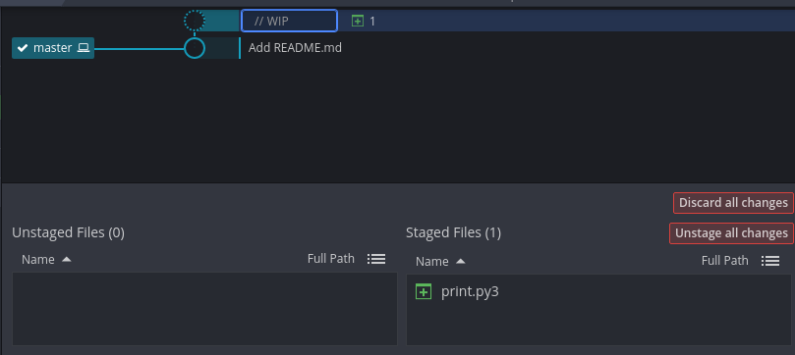
Add: stage
Stage ~ ruimte waar file/dir klaargezet worden voor commit
$ git add print.py3
$ git status
On branch master
Changes to be committed:
(use "git reset HEAD <file>..." to unstage)
new file: print.py3

Slide 5
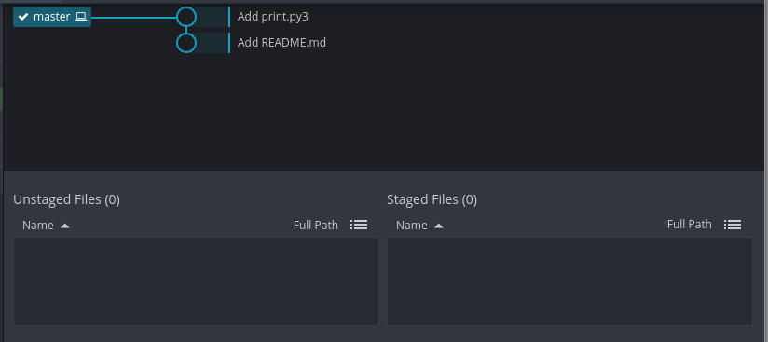
commit
$ git commit -m "Add print.py3"
[master 06adffd] Add print.py3
1 file changed, 1 insertion(+)
create mode 100644 print.py3
$ git status
On branch master
nothing to commit, working directory clean

Slide 6
log
$ git log
commit 06adffda771a2058cc62cea7ad161f21f5d78501
Author: Tim
Date: Thu Jun 8 11:27:13 2017 +0200
Add print.py3
commit e23e4e03e910939cbb9d60113561df3b9ae3560d
Author: Tim
Date: Thu Jun 8 11:25:50 2017 +0200
Add README.md
$ git log --oneline
9ab387c Updated README.md
aa29753 Updated print.py3
150ffb8 Added print.py3
1037b1d Added README.md

Slide 7
File/directory verwijderen
$ git rm print.py3
rm 'print.py3'
$ ls
README.md
$ git status
On branch master
Changes to be committed:
(use "git reset HEAD <file>..." to unstage)
deleted: print.py3
$ git commit -m "Deleted print.py3"
[master ac2181f] delete
1 file changed, 1 deletion(-)
delete mode 100644 print.py3
$ git rm -r someDirectory
$ git commit -m "Deleted someDirectory"

Slide 8
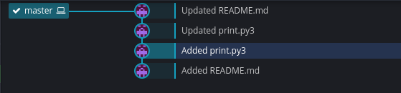
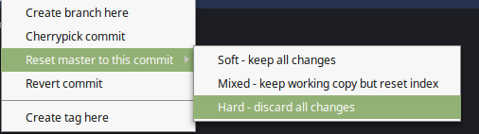

Wijzigingen ongedaan maken
Optie 1: teruggaan in de tijd
$ git log --oneline
9ab387c Updated README.md
aa29753 Updated print.py3
150ffb8 Added print.py3
1037b1d Added README.md
$ git reset --hard 150ffb8

Slide 9

Wijzigingen ongedaan maken
Optie 2: teruggaan naar een oude commit en nieuwe commit met aangebrachte wijzigingen maken
$ git log --oneline
9ab387c Updated README.md
aa29753 Updated print.py3
150ffb8 Added print.py3
1037b1d Added README.md
$ git checkout 150ffb8
# bekijk de oude toestand
$ git checkout 9ab387c
# maak wijzigen, add, commit
$ vi print.py3
$ git add print.py3
$ git commit -m "Updated print.py3, removed error"
Updated print.py3, removed error

Slide 10
Wijzigingen ongedaan maken
Optie 3: unstaged changes ongedaan maken
$ rm -rf *
# oops :-)
$ git reset --hard HEAD
# eventueel met clean om untracked files / directory te
# verwijderen
$ git clean -f -d

Slide 11
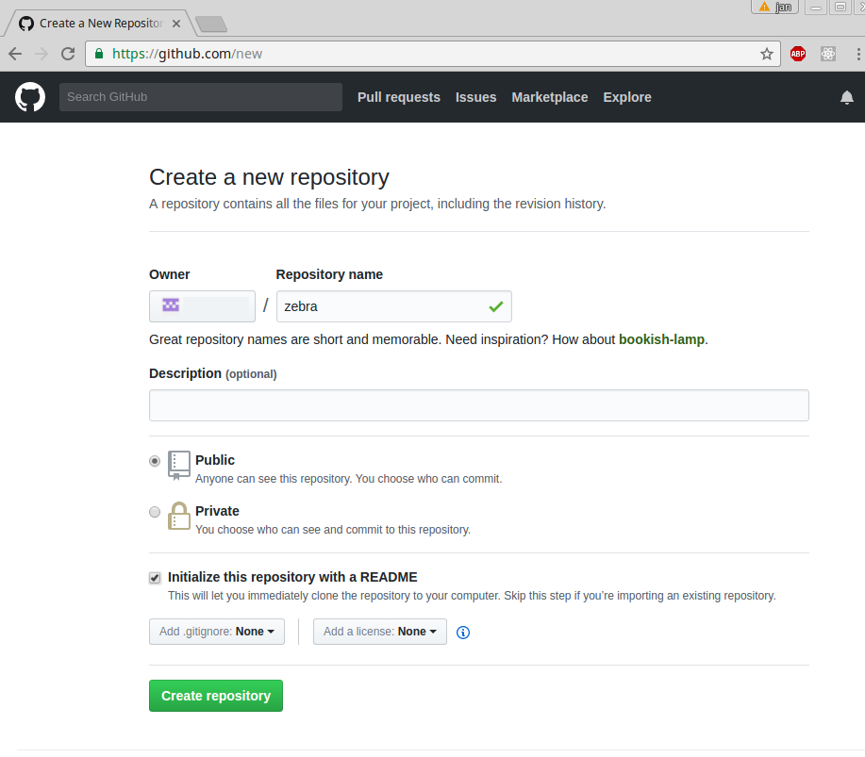
Online repository
tim

Slide 12
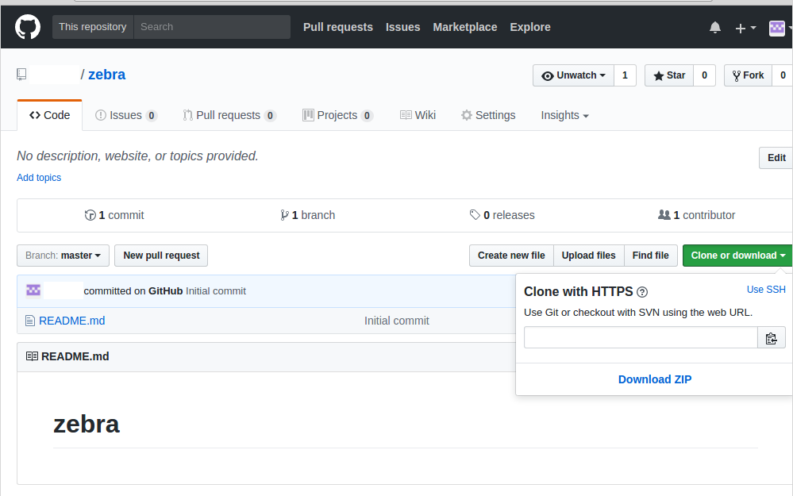
Online repository
tim
tim
https://github.com/tim/zebra.git

Slide 13
$ git remote add origin https://github.com/tim/zebra.git
$ git pull origin master
$ ls
README.md
$ vi print.py3
$ git add print.py3
$ git commit -m "Added print.py3"
[master b01039b] Added print.py3
1 file changed, 1 insertion(+)
create mode 100644 print.py3
$ git push origin master
Username for 'https://github.com': tim
Password for 'https://tim@github.com':
Counting objects: 3, done.
Delta compression using up to 4 threads.
Compressing objects: 100% (2/2), done.
Writing objects: 100% (3/3), 294 bytes | 0 bytes/s, done.
Total 3 (delta 0), reused 0 (delta 0)
To https://github.com/tim/zebra.git
a8a3582..b01039b master -> master

Slide 14
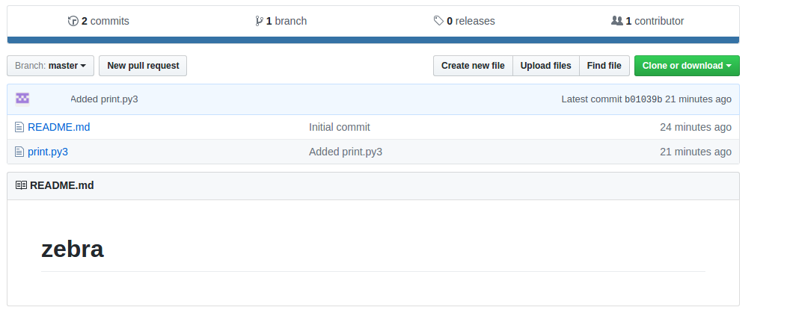
Online repository
tim

Slide 15
Problemen :-)
situatie: na pull wordt er een andere wijziging doorgevoerd in de online repository.
push kan niet automatisch gemerged worden
git push origin master
Username for 'https://github.com': tim
Password for 'https://tim@github.com':
To https://github.com/tim/zebra.git
! [rejected] master -> master (fetch first)
error: failed to push some refs to
'https://github.com/tim/zebra.git'
hint: Updates were rejected because the remote contains work that you do
hint: not have locally. This is usually caused by another repository pushing
hint: to the same ref. You may want to first integrate the remote changes
hint: (e.g., 'git pull ...') before pushing again.
hint: See the 'Note about fast-forwards' in 'git push --help' for details.

Slide 16
Problemen :-)
git pull origin master
remote: Counting objects: 3, done.
remote: Compressing objects: 100% (2/2), done.
remote: Total 3 (delta 0), reused 0 (delta 0), pack-reused 0
Unpacking objects: 100% (3/3), done.
From https://github.com/willekej/zebra
* branch master -> FETCH_HEAD
b01039b..a2f40f1 master -> o/master
Auto-merging print.py3
CONFLICT (content): Merge conflict in print.py3
Automatic merge failed; fix conflicts and then commit the result.

Slide 17
Problemen :-)
cat print.py3
<<<<<<< HEAD
print("ok")
=======
print("OK")
>>>>>>> a2f40f14af51b9167b37bdffc4bc49d02a59d195
Editeer print.py3
Commit
Push

Slide 18
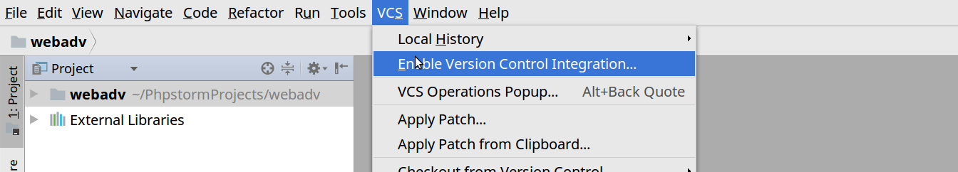
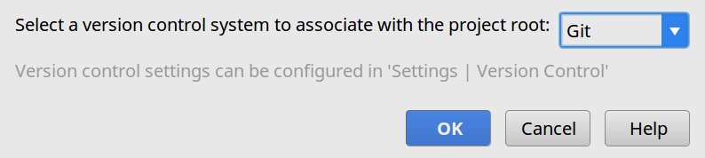
PHPStorm

Slide 19
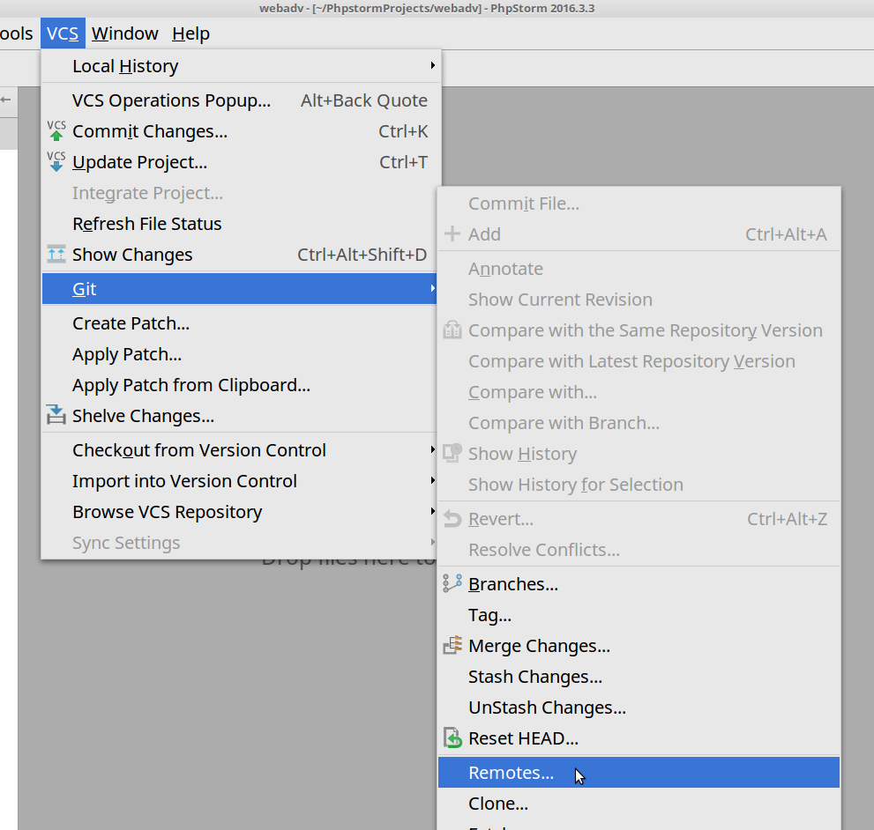
PHPStorm

Slide 20
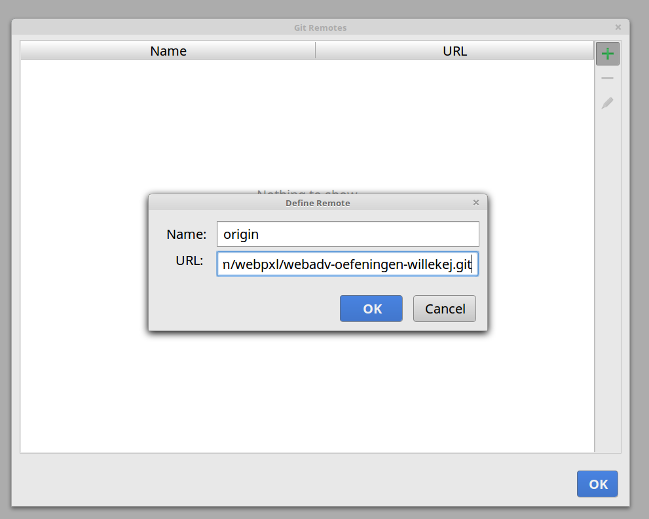
PHPStorm

Slide 21
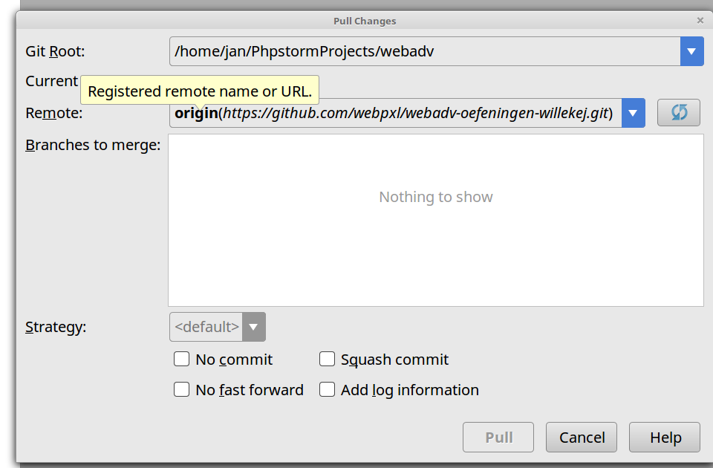
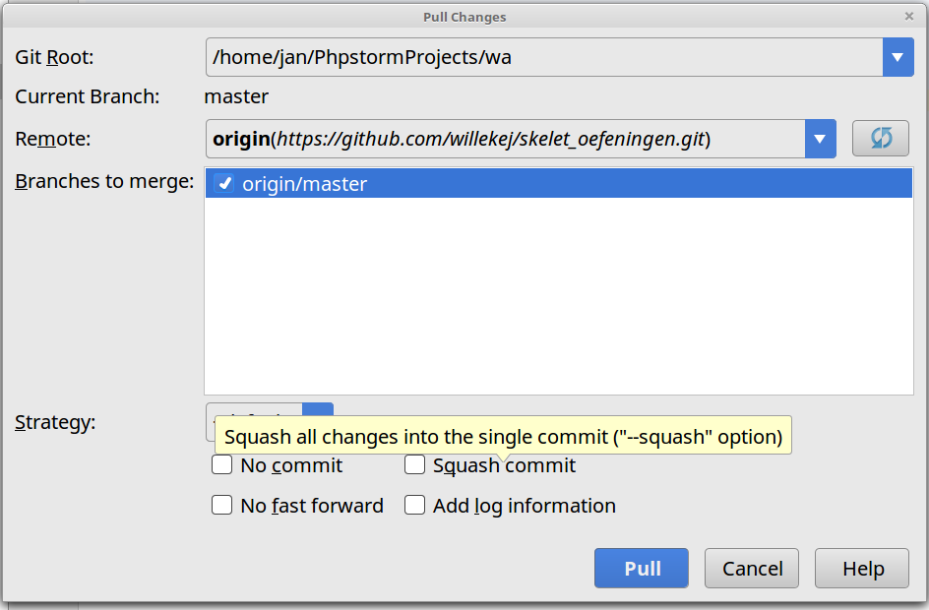
PHPStorm

Slide 22
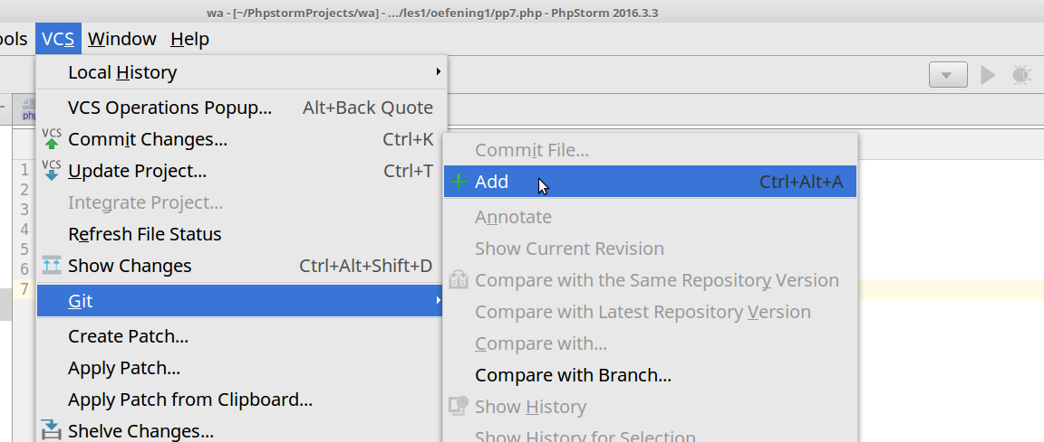
PHPStorm

